Slide 1

Northwind’s Sales
Statistical Analysis
Presented by: Fernando Aguilar Islas
Notes:
Board of directors, senior management, executives.

Slide 2
Introduction
Background
Northwind has been experiencing global growth during the past couple of years. Given its global operations, it has been exposed to both, global and local competitors, all competing for market share while struggling to remain profitable. Northwind has to find sales strategies that either increase its revenue or decreases costs, to increase its profitability.

Slide 3
Sales Strategies
Discounts
Employee Productivity
Discounts are an essential part of business, however it is imperative to find out their efficiency at driving sales up.
It is best business practice to encourage above average performance and review poor performing employees.
Product Categories
Shipping Costs
Ultimately, shipping costs end up being perceived from customers as part of the price paid for a product. Hence, this should be as low as possible.
Identify investment opportunities in specific product categories.

Slide 4
Hypothesis Testing
Statistical tool to test conventional wisdom.
Includes two mutually exclusive hypotheses. The null and alternate hypothesis.
Significance level is the probability of rejecting the null when it is true.
Methodology
Welch’s T-test, ANOVA and Effect Size
Welch’s t: Find difference in means amongst wo samples.
ANOVA: Find differences in means amongst more than two categorical values.
Effect size: How big is the difference.

Slide 5
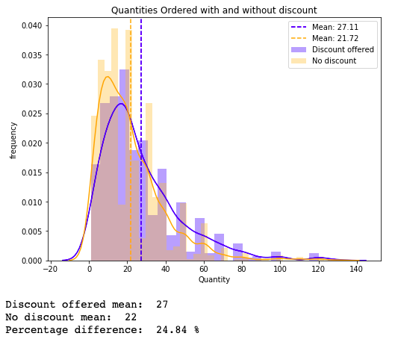
Discounts Effectiveness
Do discounts have a statistically significant effect on the number of products customers order?
Findings
Discounts increased the average quantity ordered.
Effect size was larger at 5% and 15% discounts.
Recommendations
Keep offering discounts to customers.
Incentivize employees that do not use discounts to avoid excessive and unnecessary discounting.
In marketing materials, limit discounts to 5% and 15%.

Slide 6
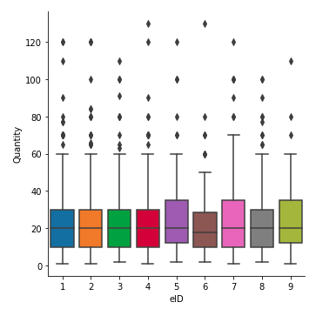
Employee Productivity
Are certain employees more productive than others?
Findings
There was no statistically difference in the mean sales level amongst employees.
Recommendations
More senior employees should be held to a higher standard, and be expected deliver above average results.
Review incentives in place that favor career advancement according to performance level.
Prioritize collaboration amongst peers.

Slide 7
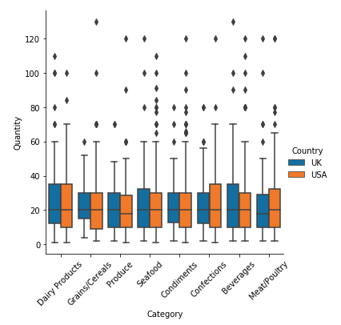
Product Categories
Do certain product categories have higher demand?
Findings
There are no differences in average quantities ordered amongst categories.
Recommendations
Keep expanding current product portfolio in all categories. Categorical differences may appear as the market reaches saturation.

Slide 8
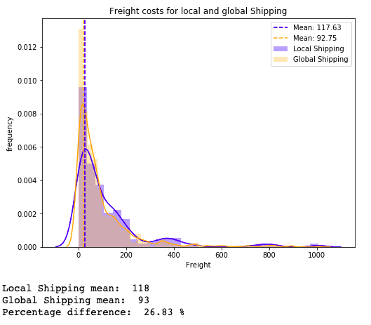
Shipping Costs
Findings
International freight is less expensive than local shipping.
Recommendations
Deal directly with local shippers, rather than relying on the current international shippers since they may be outsourcing local shippers, thus, increasing costs by acting as intermediaries.

Slide 9
Future Work
Conduct tests with actual dollar figures instead of just product quantities.
Test current shippers delivery times.
Test individual products’ price elasticities of demand per region.
Test for differences in profitability amongst territories.

Slide 10
Thank You
Any Questions?

